Slide 1


Securing the future of European business
Beate Sjåfjell, University of Oslo
#SustainabilityIsPossible
@UniOsloSMART #SMARTproject
Sustainable Market Actors for Responsible Trade (SMART)
Notes:
Sustainable value creation within planetary boundaries. A comprehensive reform of corporate purpose and duties of the corporate board

Slide 2
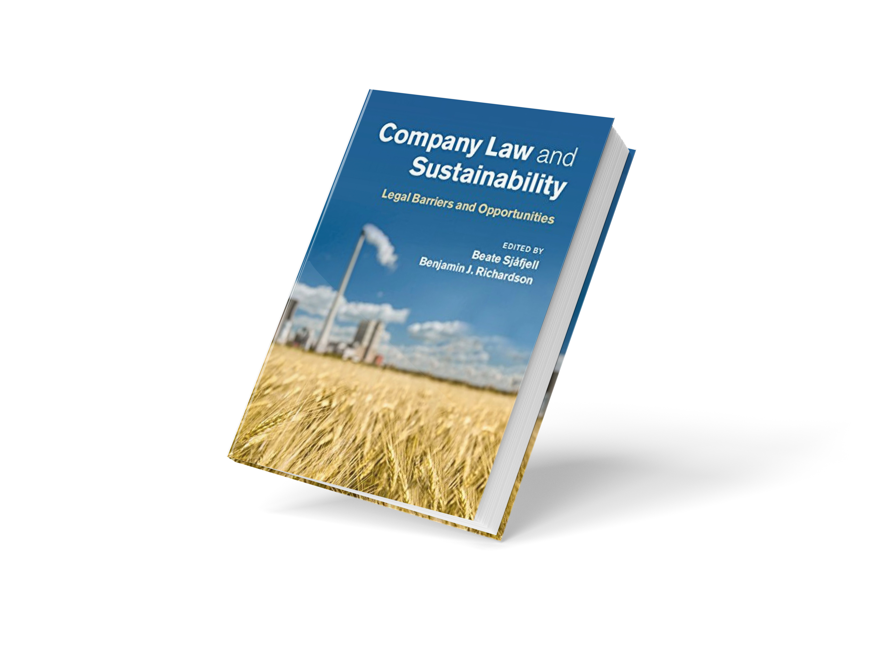
Shareholder Primacy:
The Main Barrier to Sustainable Companies
Sjåfjell, Johnston,
Anker-Sørensen & Millon
Chapter downloadable at SSRN:
ssrn.com/abstract=2664544
Notes:
Through extensive multijurisdictional analysis over the last decade my teams and I have identified the social norm of shareholder primacy – the drive to maximise returns for investors - is a main barrier.
Clash of norms – the voluntary is insufficient
Mention here the Ruggie Company Law Project
The Sustainable Companies Project (2010-2014)
The SMART Project (2016-2020)
The Cambridge Handbook Project (2017-2019)

Slide 3


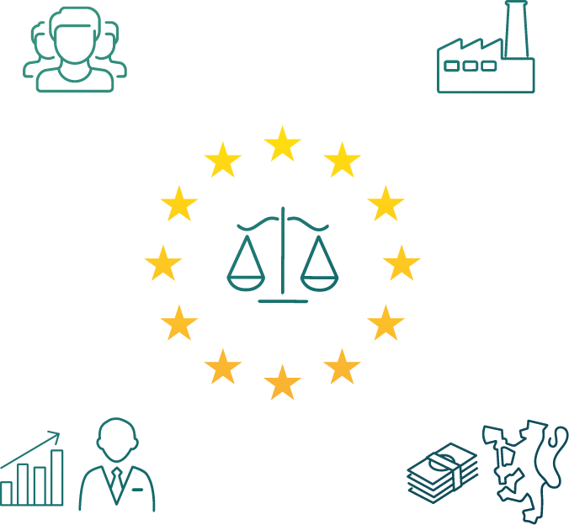

Obstacles to Global Sustainable Business
Sjåfjell, Mähönen, Johnston & Cullen
Report downloadable at SSRN:
ssrn.com/abstract=3354401
Notes:
Broader context
Complexity
Clash of norms! Voluntary initiatives, reporting. It. Does. Not. Work.
Our SMART analysis has confirmed: Shareholder primacy is a systemically entrenched barrier for corporate sustainability.
Denoting shareholder primacy as a barrier of such significance is a short form for a complex mix of perceived market signals and economic incentives, informed by path-dependent corporate governance assumptions and postulates from legal-economic theories. Shareholder primacy should be distinguished from the legal norm denoted shareholder value, which we find notably in the UK. That this distinction often is not made is symptomatic of the dominance of the shareholder primacy thinking, also in corporate law doctrine.

Slide 4
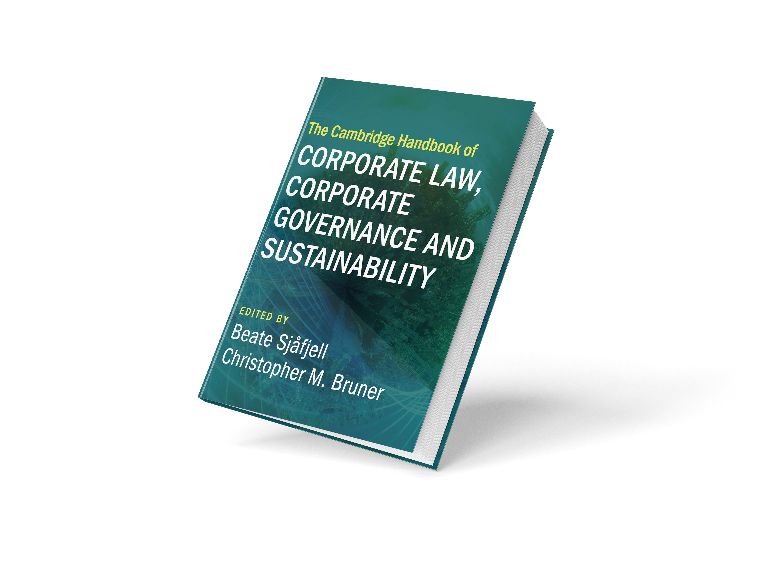
Cambridge Handbook of Corporate Law, Corporate Governance & Sustainability
Sjåfjell & Bruner (eds).
Our introductory chapter is downloadable from SSRN:
ssrn.com/abstract=3383384
Notes:
US, Canada, Australia, New Zealand
The EU
UK, the five Nordic countries, Germany, the Netherlands, France, Italy,
A chapter canvassing Eastern European countries
Russia, the Pacific Alliance (Chile, Colombia, Mexico, and Peru)
Brazil, South Africa, Nigeria, Mauritius, and a chapter on reporting with a comparative study of Egypt, Equatorial Guinea, Kenya, Nigeria, Botswana and South Africa,
the Solomon Islands
A chapter on indigenious peoples
China, Japan, India, Indonesia, Hong Kong, Singapore
A chapter on Islamic finance (Dubai, Oman, Malaysia)
And on various possible drivers for change

Slide 5

Financial risks of unsustainability

Slide 6
Reforming company law to redefine
The purpose of the company
The duties of the board
And what counts
Notes:
It must go beyond permissive
Beyond UK CA 2006, beyond Business Roundtable
To push back against this, it is crucial that company law takes back the power to define the purpose of the company and the duties of the board.
Key to change

Slide 7

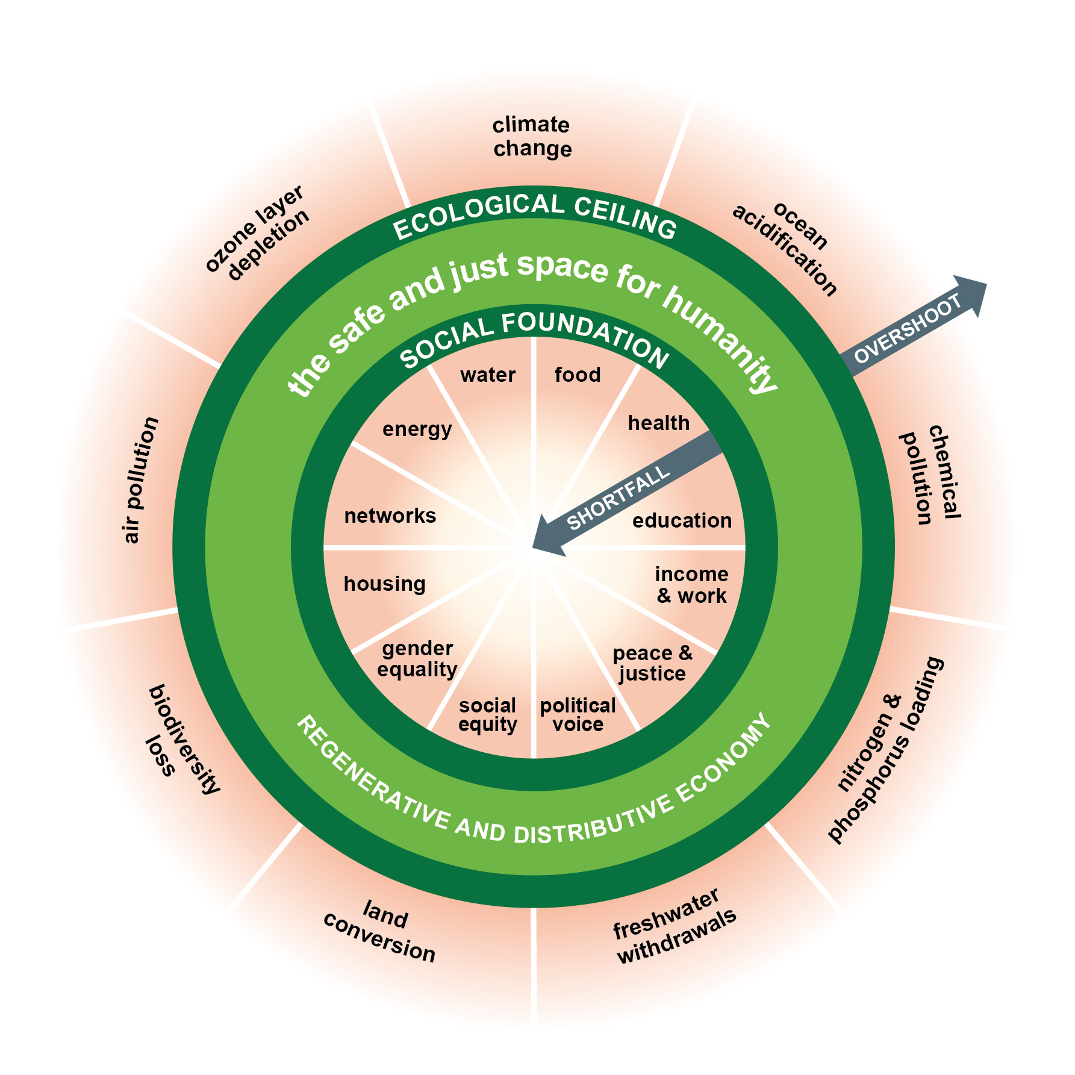

…to create sustainable value within planetary boundaries…
Notes:
Redefining the purpose
The purpose of the undertaking is to create sustainable value within planetary boundaries, balancing the interests of its investors and other involved and affected parties

Slide 8
Redefining the duties of the board
Commit:
to the overarching purpose
Integrate:
throughout the business
Assurance:
of systems and processes
Notes:
Adjust business model, where necessary
Strategy
Integrate in internal control and risk management systems
Public and private enforcement
Verified, relevant and reliable reporting

Slide 9
Sustainability is possible, with legislative reform supporting the transition
We welcome your input to our SMART reform proposals: smart.uio.no__
@BeateSjafjell
#SustainabilityIsPossible #SMARTproject
SMART is funded by the European Union under the Horizon 2020 programme, grant agreement 693642.
The contents of this presentation are the sole responsibility of the SMART project
and do not necessarily reflect the views of the European Union.

