Slide 1


Financing the transition to sustainability
Jay Cullen, University of York & University of Oslo
Brussels, 19 February 2020
#SustainabilityisPossible #SMARTproject @UniOsloSMART

Slide 2
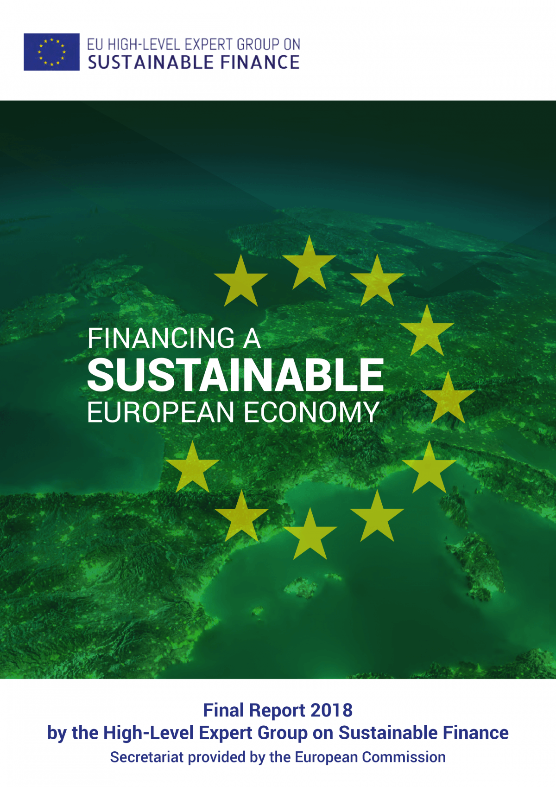
Some progress… but it is not enough
”Meeting Sustainable Development Goals (SDGs), the Paris Agreement commitments and other environmental goals will require substantial investments far beyond what the public sector can muster. Mobilising and re-directing private capital is necessary for meeting EU’s climate, environmental and sustainability commitments.”
Notes:
EU Sustainable Finance Initiative (2018)
Taxonomy Regulation (2019)
Disclosure Regulation (2019)
Amended Benchmarks Regulation (2019)
European Green Deal (December 2019)
European Green Deal Investment Plan (January 2020)
Just Transition Mechanism (January 2020)
EU policies missing planetary boundaries and social foundation
Climate change is only one dimension of planetary boundaries
Social foundation: not only safe but also just space for all humanity
Not only Europe but the whole planet
Protects finance from the environment, rather than the environment from finance
Ignores climate change as market failure
Creates new subset of financial products/instruments offering higher than normal yields
Will likely generate pressure for more asset mining to generate returns
In practice, lacks focus on ESG, instead focusing on climate
Places too much emphasis on information & transparency
Places too much emphasis on private finance
From climate finance to planetary boundaries based and societally just sustainability finance
Eg. biodiversity-related financial risks
Taking all UN SDGs seriously
Taking public finance seriously: sustainable and transparent
From Green Taxonomy to Brown Taxonomy
Making Benchmarks sustainable
175bn EURO per year needed. EU economy is approx. 15 trillion EURO. So barely 1% of economy.

Slide 3
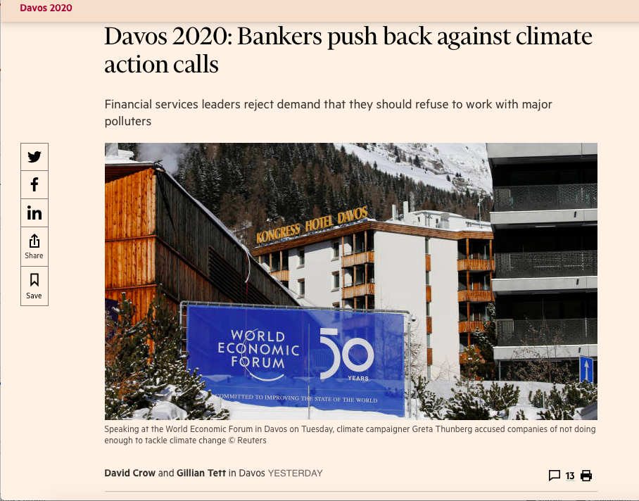
Why?

Slide 4
Why?

Slide 5
ECB mandate
Article 11 TFEU requires that: ‘Environmental protection requirements must be integrated into the definition and implementation of the Union’s policies and activities, in particular with a view to promoting sustainable development’
Notes:
TFEU Art 127[1]:
“The primary objective of the European System of Central Banks shall be to maintain price stability. Without prejudice to the objective of price stability, the ESCB shall support the general economic policies laid down in Article 3 of the Treaty on European Union.”
TEU Article 3[3] states that the EU internal market should:
“work for the sustainable development of Europe based on balanced economic growth and price stability, a highly competitive social market economy, aiming at full employment and social progress, and a high level of protection and improvement of the quality of the environment.”

Slide 6
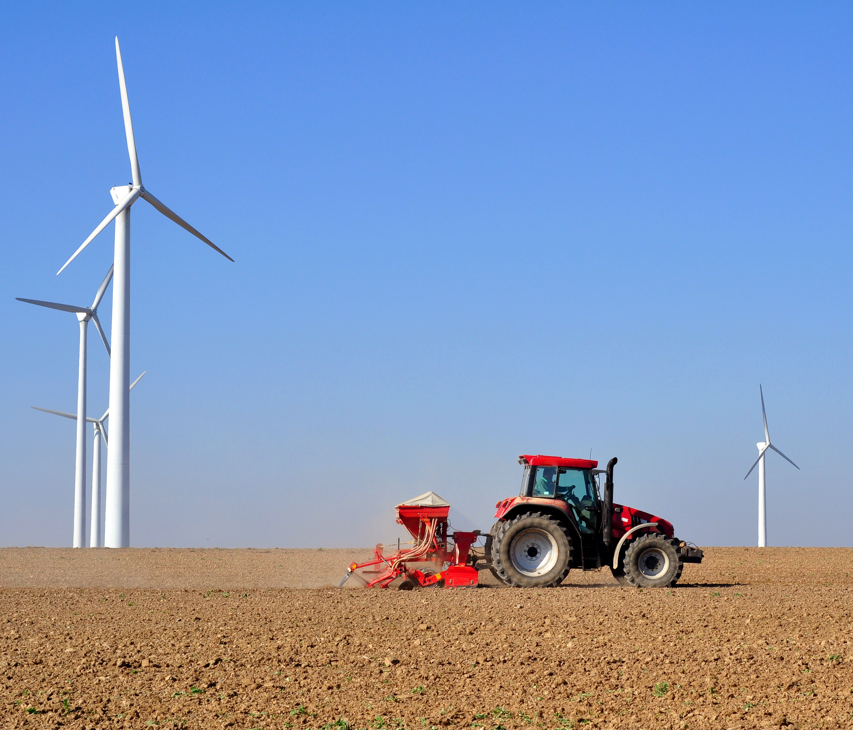
Bank capital
‘[a] ‘brown-penalising’ factor, raising capital requirements towards sectors with strong sustainability risks, would yield a constellation in which risk and policy considerations go in the same direction [as rewarding green projects]. Moreover, it would be more focused and easier to rationalise as capturing the risk of sudden value losses due to ‘stranded assets’.’
Notes:
The EBA should abandon its ‘Green Supporting Factor’ in bank capital requirements.
The EBA should introduce a ‘Brown Penalising Factor’ in bank capital requirements for assets carrying a high climate and/or sustainability risk.
The EBA should dis-incentivise securitisations of brown assets.

Slide 7
Brown asset penalizing factor

Slide 8
Collateral eligibility
“A modest tilting approach could reduce carbon emissions in the central bank’s corporate bond portfolio by 44 percent and lower the cost of capital for low-carbon companies by 4 basis points.”
Notes:
Central bank collateral frameworks bestow liquidity benefits
Allow borrowers to access finance more cheaply = higher security price and lower yield
Schoenmaker 2019;

Slide 9

From Green to Brown Taxonomy
Notes:
NGFS:
“A taxonomy of “brown” assets based on clearly defined criteria is important to identify which assets will be impacted by the Paris Agreement and the low-carbon and climate-resilient transition. It is a preliminary step to better assess the risk profile of “brown” assets and ensure that disclosures by financial institutions are consistent and comprehensive.”
Excluding such activities from any Taxonomy will allow companies which undertake them to continue to avoid scrutiny of their portfolios and any potential impact on their financial profile. It will also add to the cost base of companies and product providers which engage in sustainable activity; these costs will not by borne by companies which engage in the most damaging ventures. A tool of this nature would also enable central bankers and financial regulators to better identify the sectors of activity most exposed to climate and environmental related financial risks (for example, from regulatory changes, litigation, asset stranding, physical climate impacts etc). The development of a taxonomy could also be very useful in other areas of financial activity, for example investment services provided under MiFID II and the forthcoming Investment Firms Regulation.

Slide 10
Broaden the Taxonomy to banks
The EBF and UNEP FI have launched a joint project to assess the application of the EU taxonomy and identify sustainable activities in banks’ lending portfolios. According to the EBF, “[t]he objective of the project is to develop and promote high-level voluntary guidelines that will facilitate the identification of sustainable activities in banks’ portfolios based on the EU taxonomy, including use cases, disclosure guidance and recommendations.”
European Banking Federation. EBF final response to the Call for feedback on TEG report on EU Taxonomy, September 2019 at https://www.ebf.eu/wp-content/uploads/2019/09/EBF-response-to-the-Call-for-feedback-on-TEG-report-on-EU-Taxonomy-.pdf

Slide 11
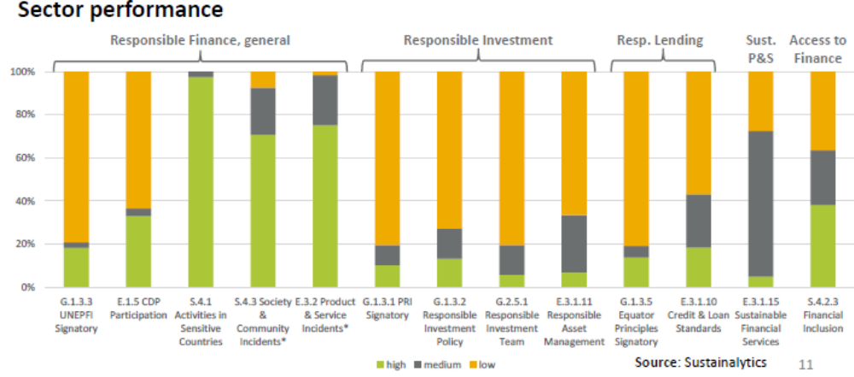
Sustainability Disclosures

Slide 12
Mandatory Sustainability Disclosures
Notes:
TCFD
“to develop voluntary, consistent climate-related financial disclosures that would be useful to investors, lenders, and insurance underwriters in understanding material risks.”
Mandatory reporting and disclosure based on TCFD
OECD Guidelines for Multinational Enterprises
Compliance guidance aimed specifically at financial institutions
Mandatory sustainability disclosures on any project funded by EU institution of EUR 10 million +

Slide 13
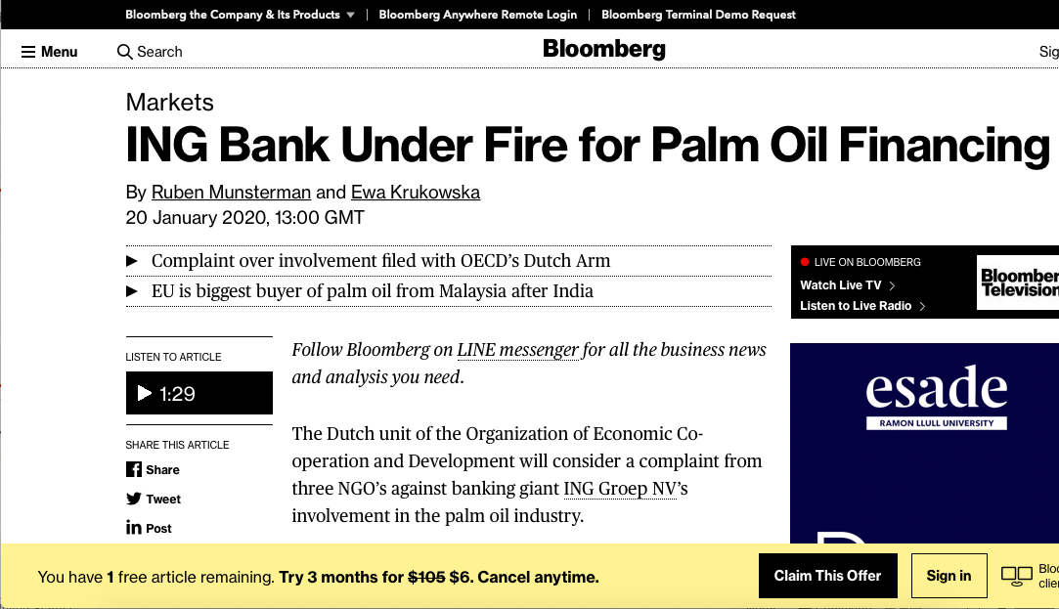
Disclosure – courts and regulators need support

Slide 14
Sustainability is possible, with legislative reform supporting the transition
We welcome your input to our SMART reform proposals: https://www.smart.uio.no/reform_proposals
#SustainabilityisPossible #SMARTproject @UniOsloSMART
SMART is funded by the European Union under the Horizon 2020 programme, grant agreement 693642.
The contents of this presentation are the sole responsibility of the SMART project
and do not necessarily reflect the views of the European Union.

